Slide 1



X
Prediction Model
ID/X Partners - Data Scientist
Presented by
Muhammad Ichsan Firdaus

Slide 2





Muhammad Ichsan Firdaus
Student at Universitas Padjajaran
A logical & analytical person who values data and facts above everything.
Bangkit 2024 Batch 2 Full Graduate ML Path
1 year experience as Laboratory Teaching Assistant Universitas Padjajaran
3rd year Informatics Engineering Universitas Padjajaran with a GPA of 3.68
Kabupaten Bogor, Jawa Barat
muhammadichsan35341@gmail.com
www.linkedin.com/in/ichsanfrds

Slide 3
Courses and Certification
<Belajar Analisis Data dengan Python> | <link certificate> <Oct, 2024>
<Linear Algebra for Machine Learning and Data Science> | <link certificate> <Oct, 2024> <Machine Learning Specialization> | <link certificate> <Oct, 2024>
<DeepLearning.AI TensorFlow Developer Specialization> | <link certificate> <Nov, 2024> <Data Pipelines with TensorFlow Data Services> | <link certificate> <Dec, 2024>
and many more…

Slide 4

About Company
id/x partners was established in 2002 by ex-bankers and management consultants who have vast experiences in credit cycle and process management, scoring development, and performance management. Our combined experience has served corporations across Asia and Australia regions and in multiple industries, specifically financial services, telecommunications, manufacturing and retail.
id/x partners provides consulting services that specializes in utilizing data analytic and decisioning (DAD) solutions combined with an integrated risk management and marketing discipline to help clients optimize the portfolio profitability and business process.
Comprehensive consulting service and technology solutions offered by id/x partners makes it as a one-stop service provider.

Slide 5
Project Portfolio
Background
Lending companies must carefully evaluate loan applications based on customer data to minimize financial risk and ensure responsible lending.
Data
Lending Club Loan Dataset (2007 - 2014)
Problem Statement
Incorrect lending decisions can lead to significant financial losses. It is crucial for loan providers to accurately assess borrowers’ creditworthiness to avoid granting loans to individuals who are likely to default.
Link code here!
Github
Project explanation video here!

Slide 6









Tech Stack
P R O G R A M M I N G
L A N G U A G E
L I B R A R I E S
T O O L S

Slide 7
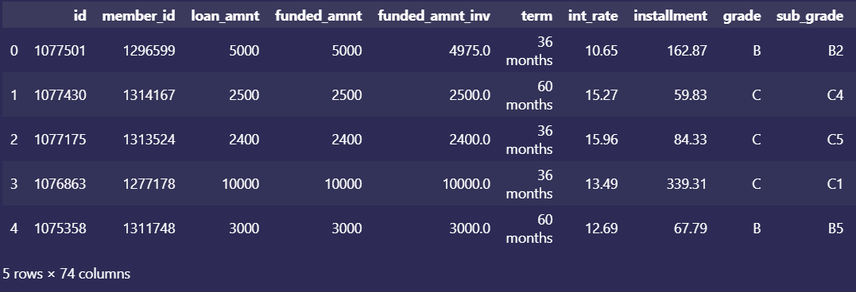
Data Understanding
I. Use Dataframe.head() function to see the overview of the data
Notes:
First, after we downloaded the necessary dataset and converted it to Dataframe

Slide 8
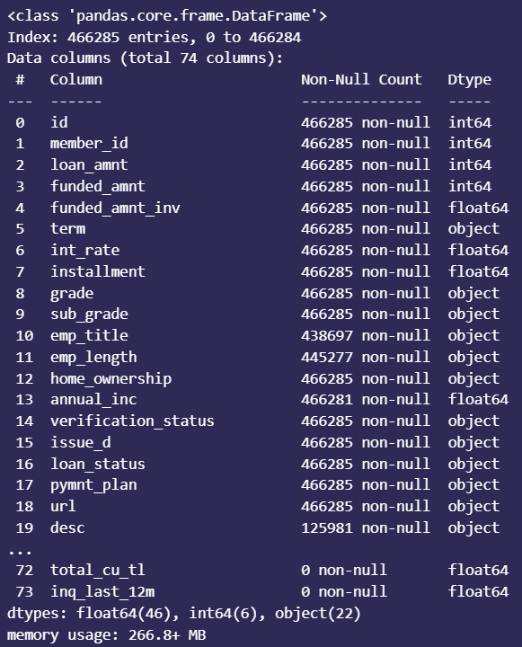
Data Understanding
II. Use Dataframe.info() function to see every features value count and datatypes
Notes:
First, after we downloaded the necessary dataset and converted it to Dataframe

Slide 9
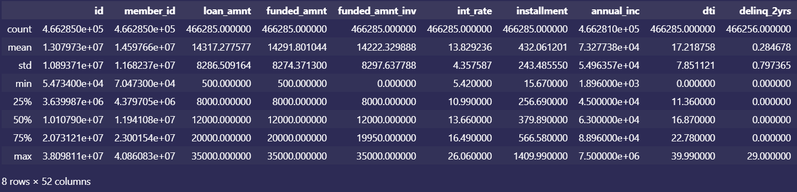
Data Understanding
III. Use Dataframe.describe() function to see descriptive statistics of the data
We can also see apply functions on a specific feature using Dataframe[‘<feature name>’].<function>()
Notes:
First, after we downloaded the necessary dataset and converted it to Dataframe

Slide 10
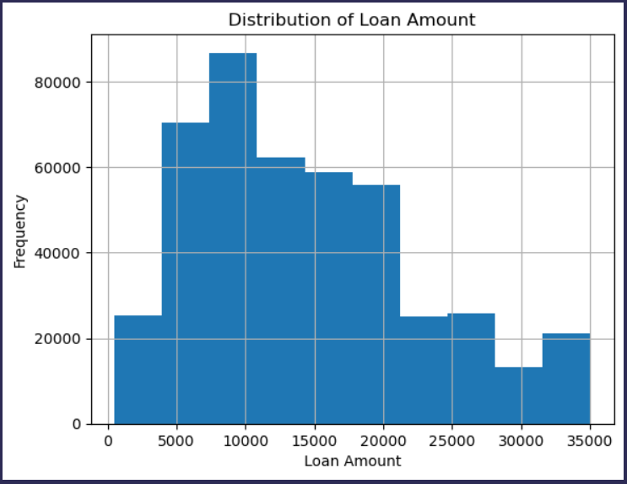
Data Understanding
IV. Use Dataframe[‘<feature name>’].hist() function to see the distribution of specific numerical feature
After understanding all the features on the data we can define that the target of this classification is the ‘loan_status’ feature
Notes:
First, after we downloaded the necessary dataset and converted it to Dataframe

Slide 11
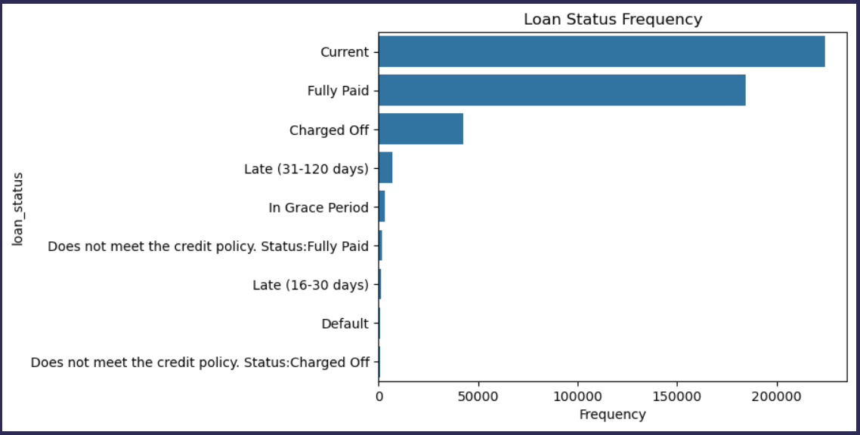
Define Target
After understanding all the features on the data we can define that the target of this classification is the ‘loan_status’ feature
But this is a Binary Classification problem, we need to compress this to 2 unique values and encode it to binary numbers
Notes:
First, after we downloaded the necessary dataset and converted it to Dataframe

Slide 12
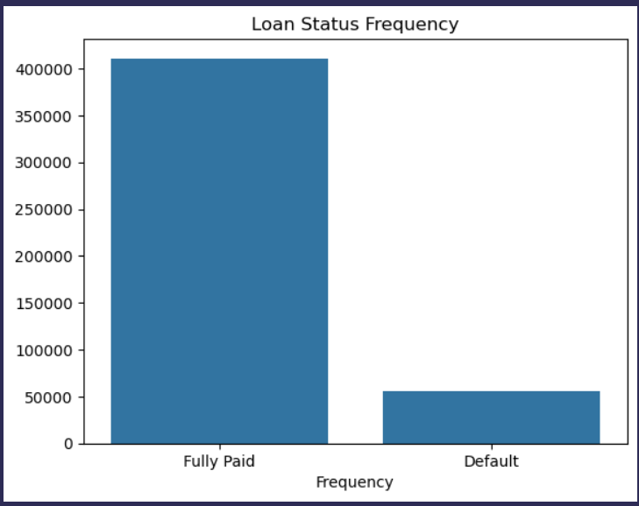
Define Target
1 for Default and 0 for Fully Paid
Notes:
First, after we downloaded the necessary dataset and converted it to Dataframe

Slide 13
Feature Engineering
I. Converting Features datatypes into int or float which aligns with the model that will be used later, namely Logistic Regression
II. Do One-Hot Encoding for Categorical features
Notes:
Documentation of Feature Engineering will be showed later on Data Preparation

Slide 14
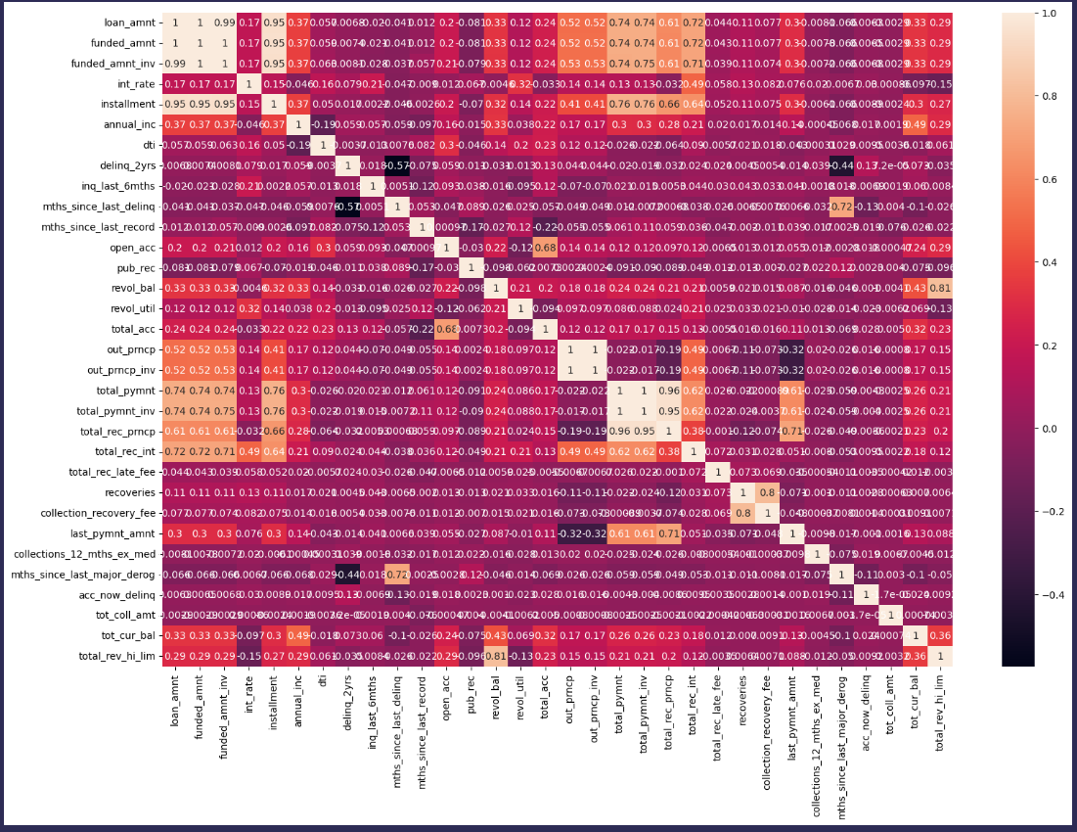
Exploratory Data Analysis
I. Use seaborn.heatmap() function to visualize correlation between numerical features
Notes:
Convoluted but at least we can make out high correlation features to spot redundant or unimportant features

Slide 15
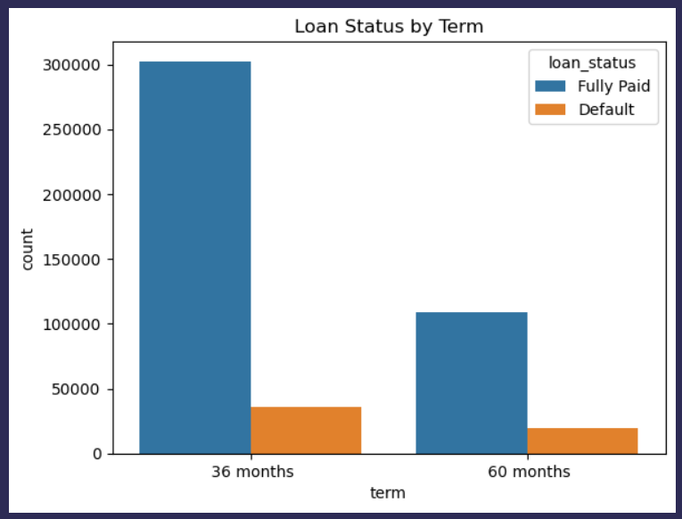
Exploratory Data Analysis
II. Thoroughly analyze the dataset to extract meaningful insights and present them through comprehensive visualizations.
Insight : Longer term returns higher ratio of default

Slide 16
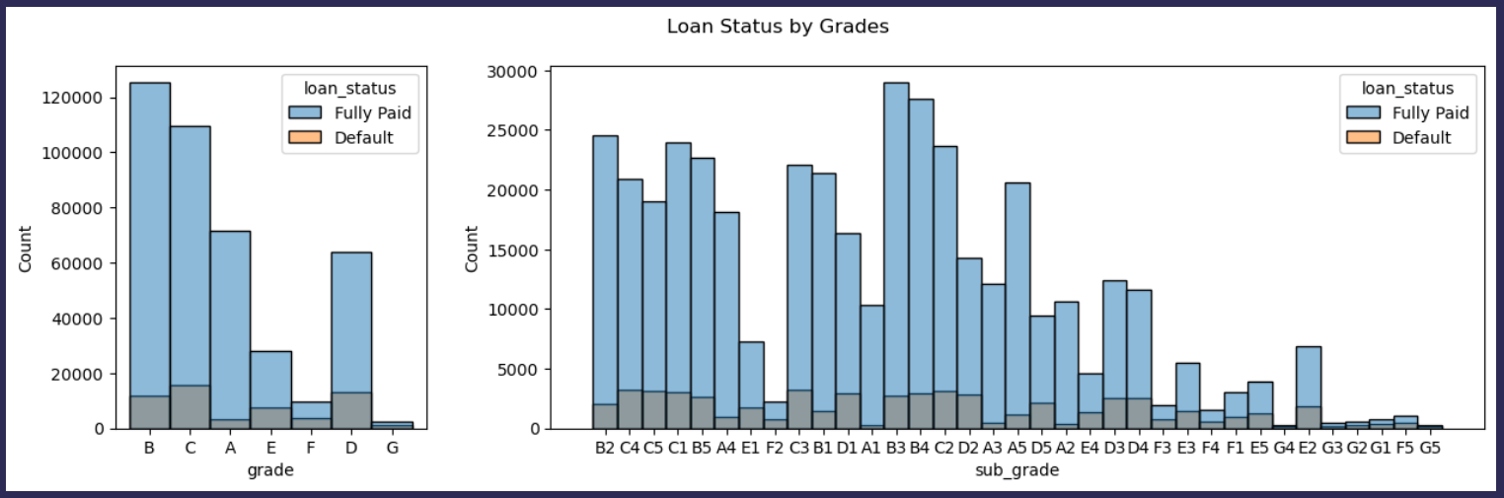
Exploratory Data Analysis
II. Thoroughly analyze the dataset to extract meaningful insights and present them through comprehensive visualizations.
Insight : Lower Grade in line with higher rate of Default

Slide 17
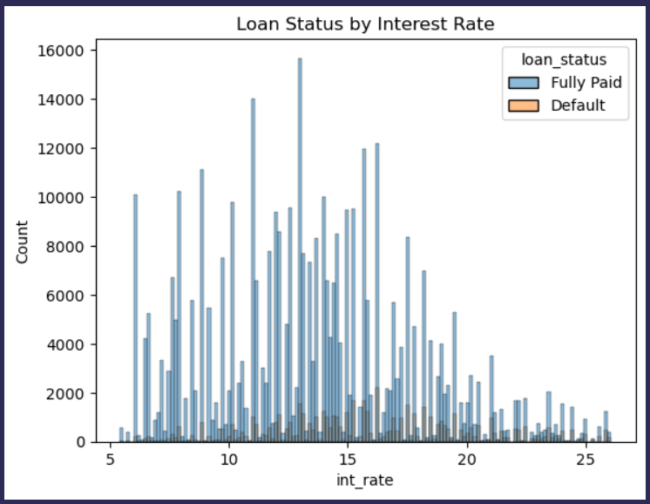
Exploratory Data Analysis
II. Thoroughly analyze the dataset to extract meaningful insights and present them through comprehensive visualizations.
Insight : Higher Interest Rate means higher probability of Loan Default

Slide 18
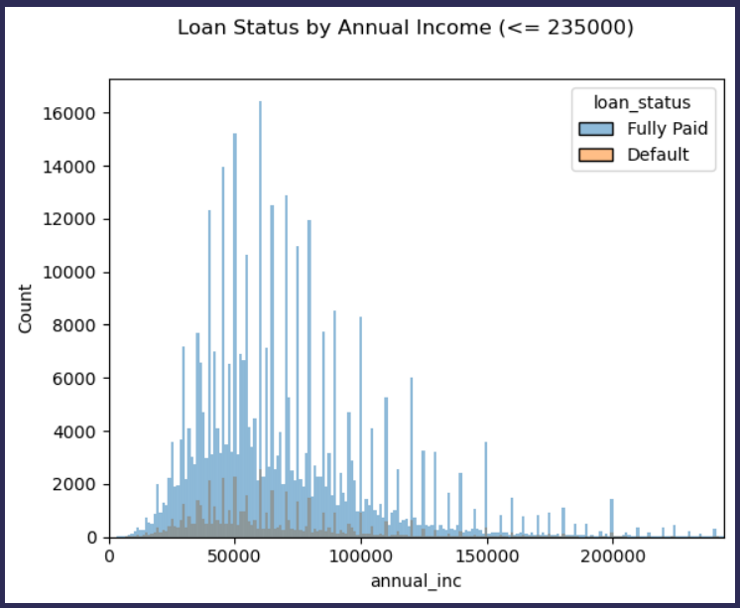
Exploratory Data Analysis
II. Thoroughly analyze the dataset to extract meaningful insights and present them through comprehensive visualizations.
Insight : Only 1% of borrowers that have annual income more than 235000

Slide 19
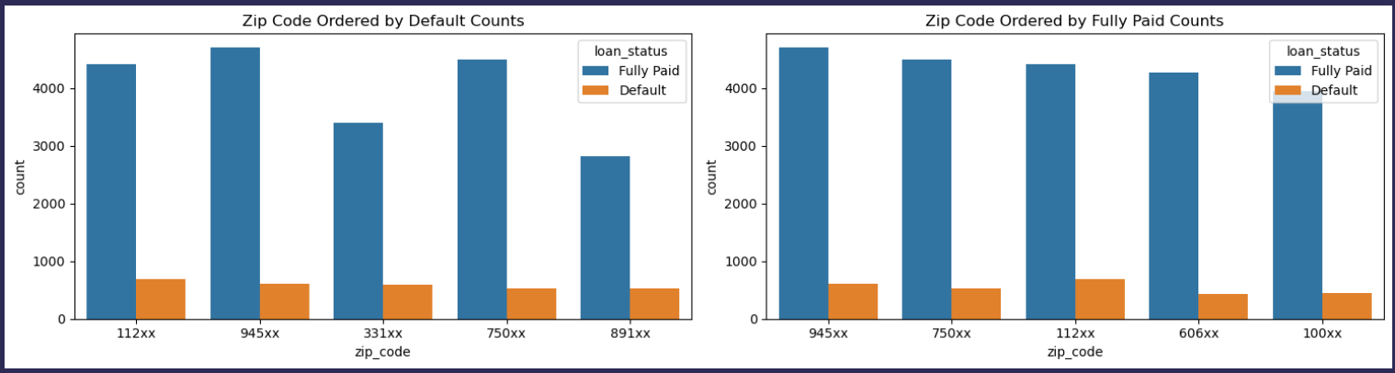
Exploratory Data Analysis
II. Thoroughly analyze the dataset to extract meaningful insights and present them through comprehensive visualizations.
Insight : Zip Code with Highest Default & Fully Paid Counts

Slide 20
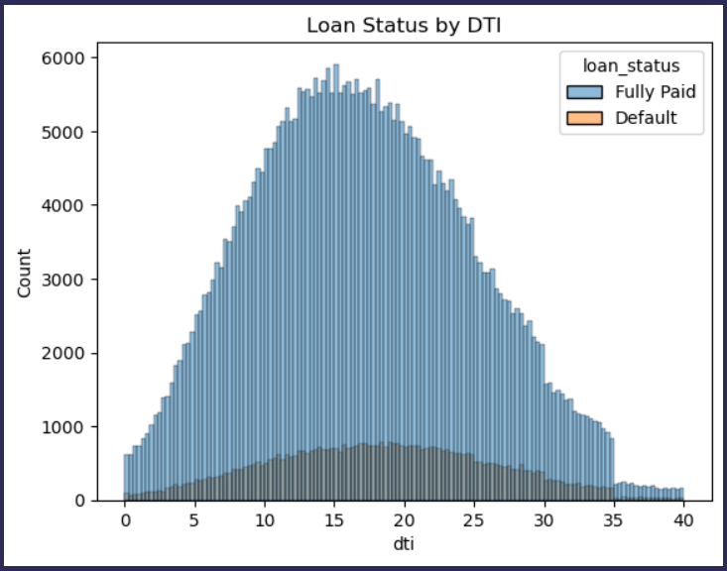
Exploratory Data Analysis
II. Thoroughly analyze the dataset to extract meaningful insights and present them through comprehensive visualizations.
Insight : Higher DTI shows higher Ratio of Default

Slide 21
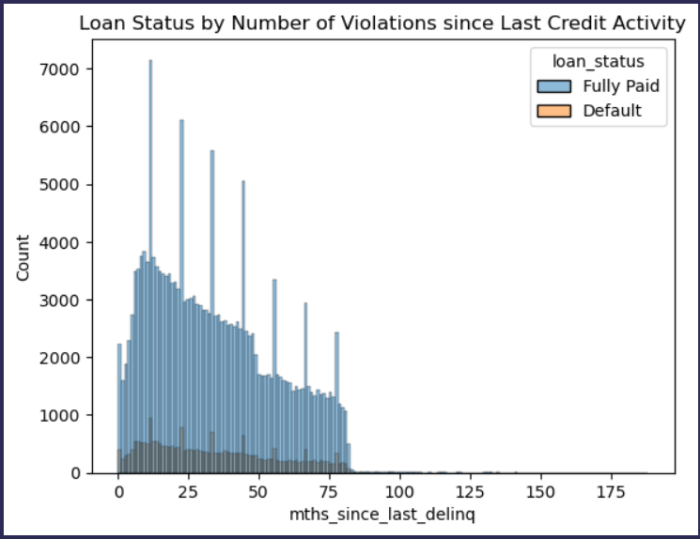
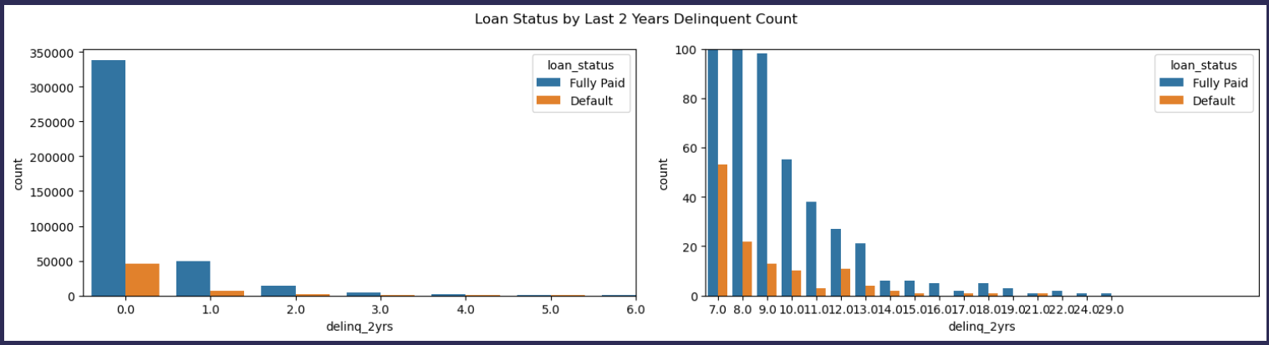
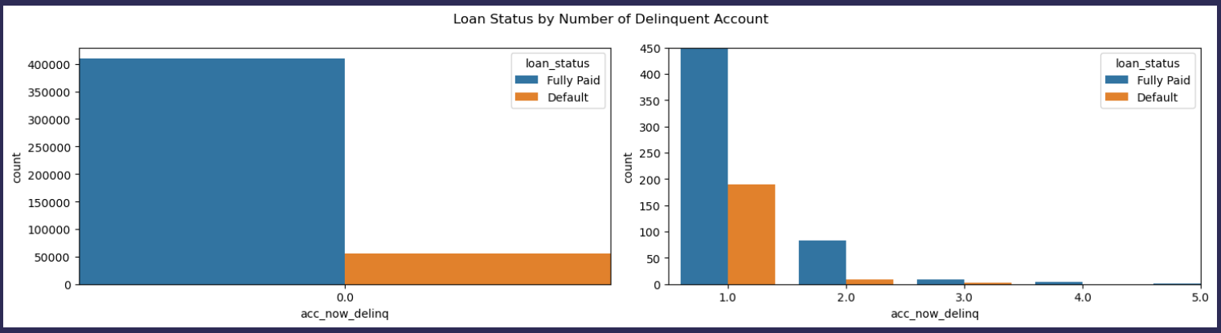
Exploratory Data Analysis
II. Thoroughly analyze the dataset to extract meaningful insights and present them through comprehensive visualizations.
Insight : Delinq number fairly affects Loan Status to Default

Slide 22
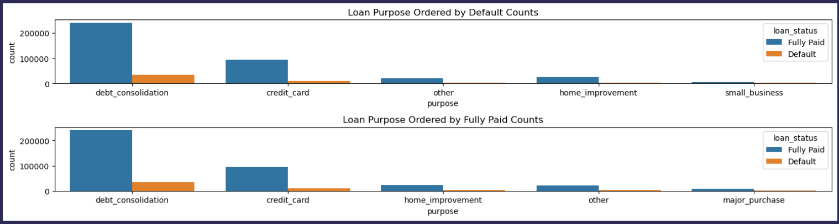
Exploratory Data Analysis
II. Thoroughly analyze the dataset to extract meaningful insights and present them through comprehensive visualizations.
Insight : Loan Purpose with Highest Default & Fully Paid Counts

Slide 23
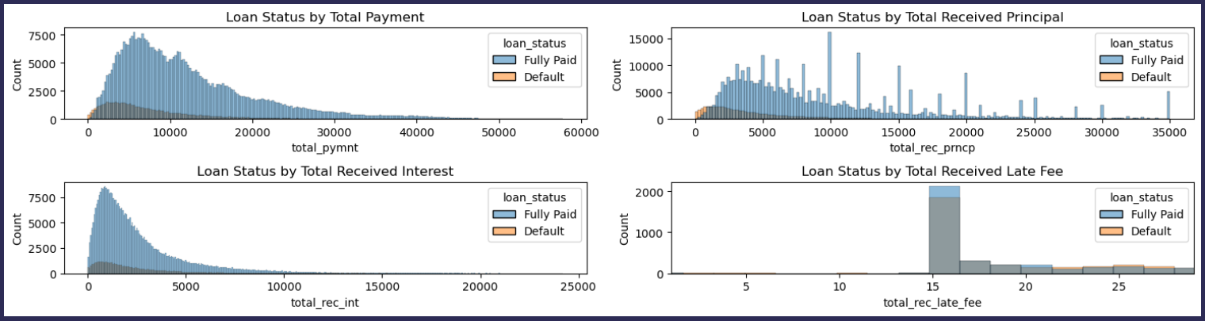
Exploratory Data Analysis
II. Thoroughly analyze the dataset to extract meaningful insights and present them through comprehensive visualizations.
Insight : High Default Rate on some sectors
and many more…
Notes:
Full EDA available in the github code

Slide 24
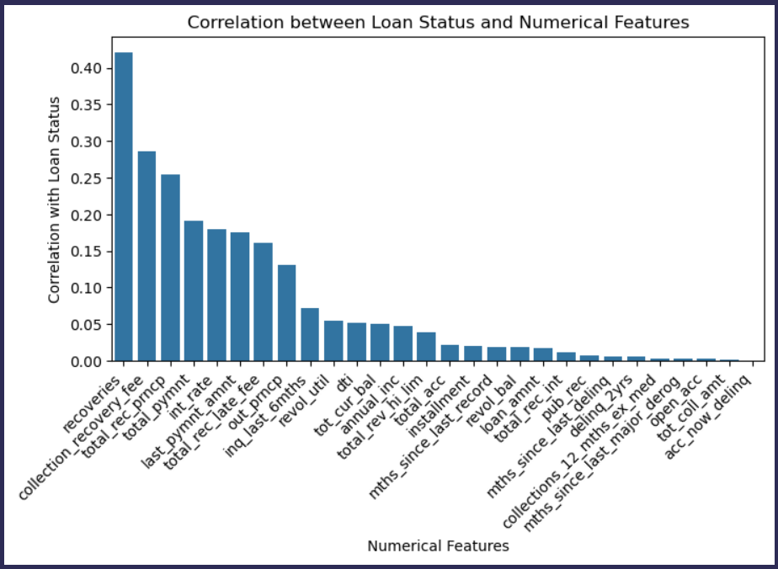
Exploratory Data Analysis
III. Analyze which Numerical feature has high correlation with Target feature.

Slide 25
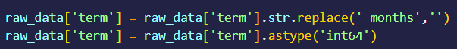
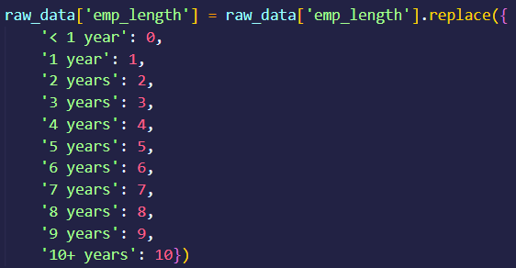
Data Preparation
Column Handling
Change Datatype
Map Features

Slide 26
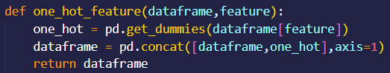
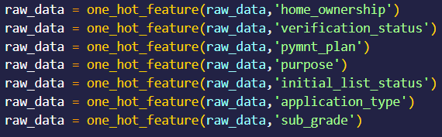
Data Preparation
Column Handling
One-Hot Encoding Function
Apply them to Categorical features

Slide 27
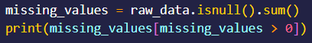
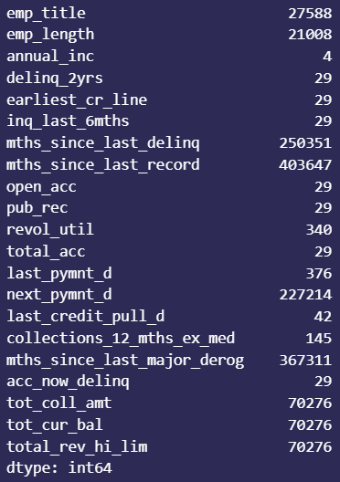
Data Preparation
Row Handling
Duplication Data check
Missing Values check

Slide 28
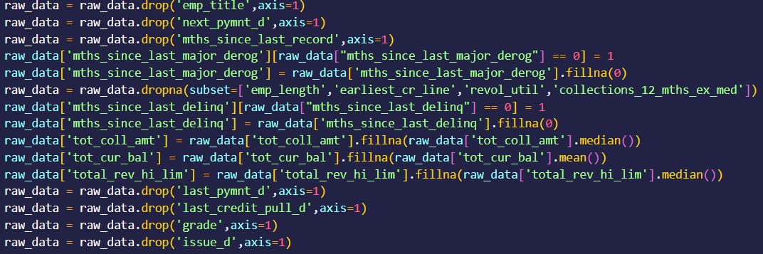
Duplication Data check
Data Preparation
Row Handling
Do Data Imputation by either drop feature, drop null rows, and/or fill with statistical value

Slide 29
Duplication Data check
Data Preparation
Train Test Split
Train Set : 80%
Test Set : 20%

Slide 30
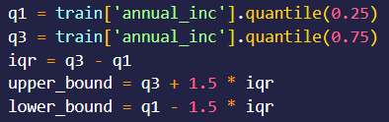
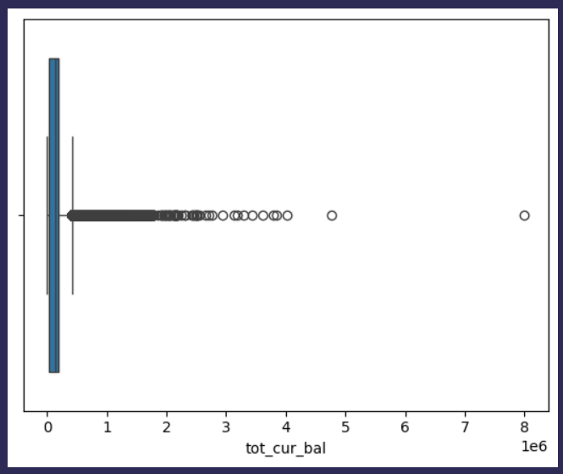
Duplication Data check
Data Preparation
Outlier Detection
Fill ‘ ’ with feature name
Visualize feature with Boxplot
Notes:
Do this to all feature that we want to remove outlier in

Slide 31
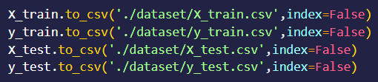
Duplication Data check
Data Preparation
Split train & test
Convert to CSV
Notes:
Do this to all feature that we want to remove outlier in

Slide 32
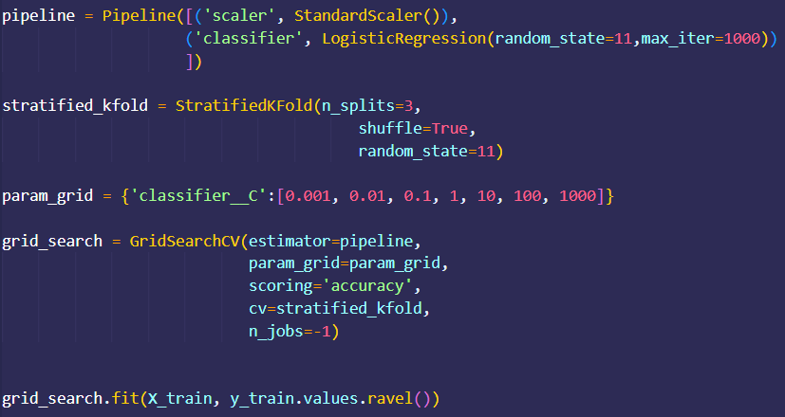
Data Modeling
1. Logistic Regression
Pipeline : Standardize Flow of Preprocess Data
StandardScaler() : Standardize Data
Stratified K-Fold : Batch Data when Training into K subsets
Grid Search : Find the best Parameter & Score

Slide 33
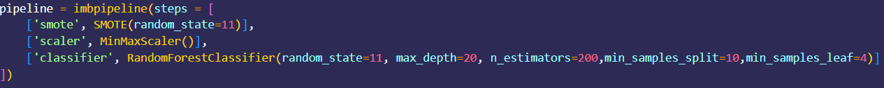
Data Modeling
2. Random Forest
Imdbpipeline : Apply SMOTE
Notes:
We dont use GridSearch because it took too long

Slide 34
Evaluation
 | Train Accuracy | Test Accuracy | F1 Score
Logistic Regression | 97.11% | 97.05% | 85.9%
Random Forest | 97.55% | 96.86% | 84.95%

Slide 35
Conclusion
Logistic Regression performs BETTER than Random Forest, because dataset features are changed to numerical which LogReg favors better
BUT
Both Model performs well with Accuracy Score > 96%

Slide 36
References
[1] PT IDX Consulting. About Us. Diakses pada 03 Februari 2025, dari https://idxpartners.com/about-us/
[2] Muhammad Ichsan Firdaus (2025, 28 Januari) Diakses pada 03 Februari 2025, dari https://github.com/ichsan-frds/IDX-Credit-Risk-Prediction
X

Slide 37
Thank You
X

